Slide 1
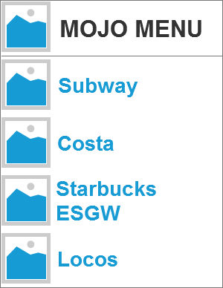
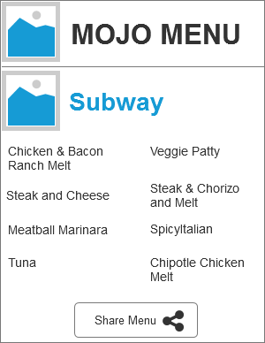
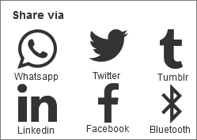
When the user is presented with a list of requested menus, they are given the option to choose their preferred one.
For example: If the user chooses Subway, they will be presented with the Subway menu. At the bottom they are given a button option to share the menu.
When the user clicks on the share button, a pop up window will show, where they have the choice to share the menu they chose on a variety of social platforms (as shown above).

